Slide 1

Pomodoro Method Device
Jason, Mikha, Nick

Slide 2

The Pomodoro Technique is a time management method that uses a timer to break down work into intervals, traditionally 25 minutes in length, separated by short breaks.
Pomodoro Method?

Slide 3
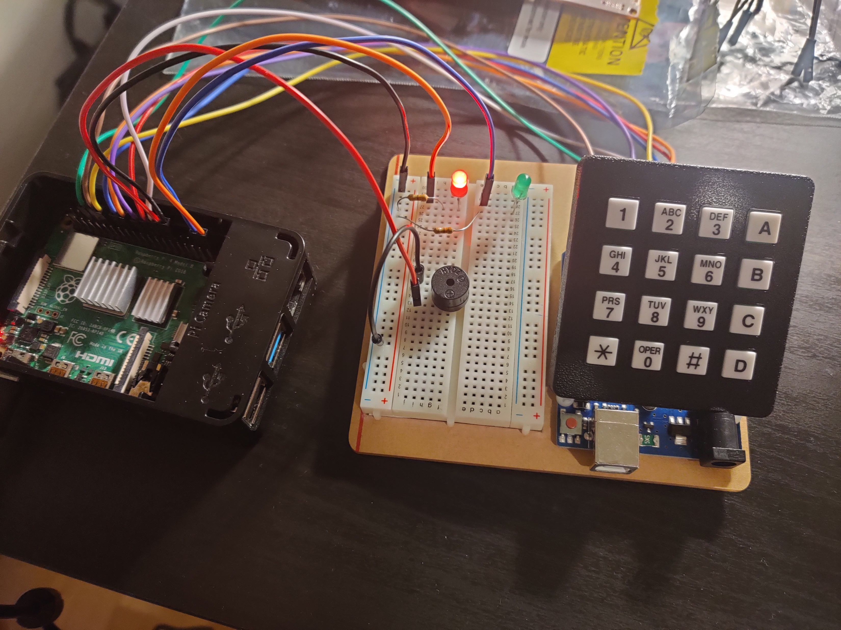
Our Hack (Hardware)
Hardware Device:
Standalone hardware that can manage Pomodoro sessions based on user input.
We think that having a standalone device is a great solution to increase productivity since if you use a phone app for something like this, you may be tempted to check other notifications on your phone and get distracted regardless.

Slide 4
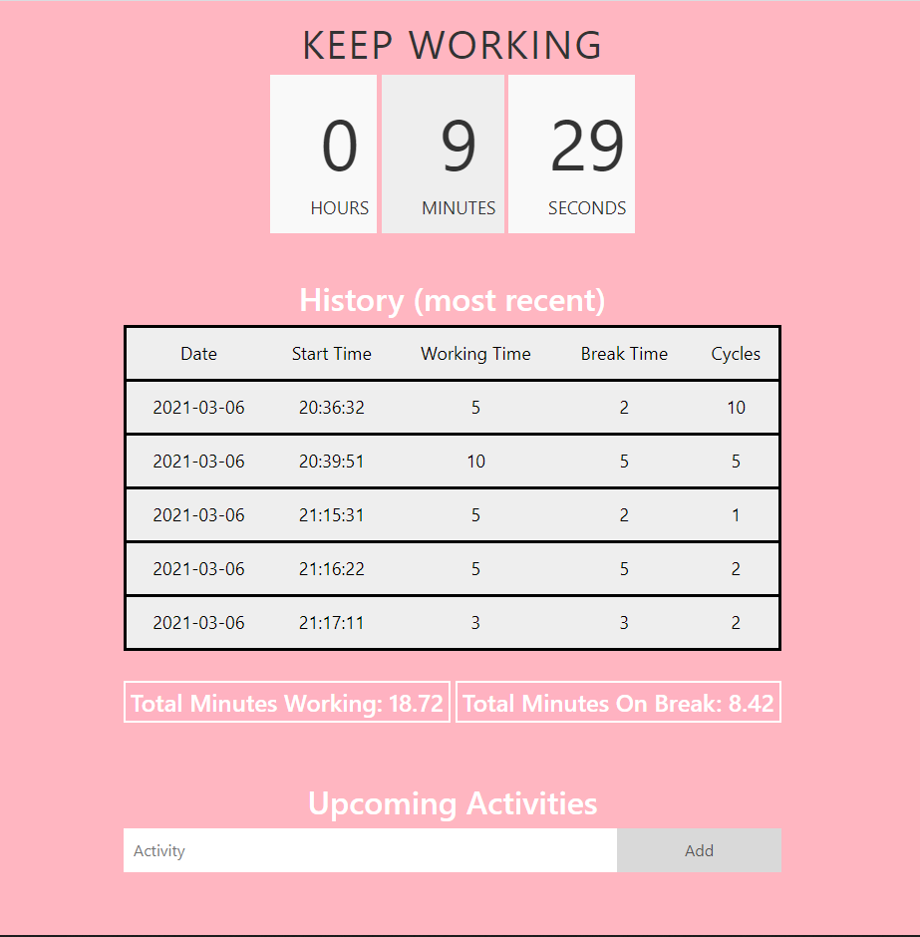
Our Hack (Software)
The hardware interfaces with a backend and database that the frontend can pull from
Consists of the current session timer, and if you are in a work/break period
Shows your history of Pomodoro sessions
Shows statistical information like total working time and total break time over all sessions.
You can add tasks/activities for better organization of your day

Slide 5
Demo Video
https://drive.google.com/file/d/1LEwXhgMvs2y6-Ic8LnIoQg2ycAxEg3b3/view?usp=sharing

